Slide 1
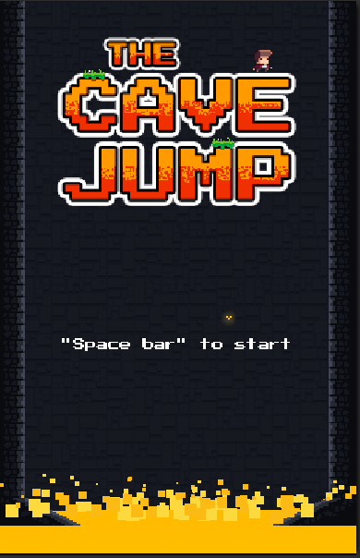
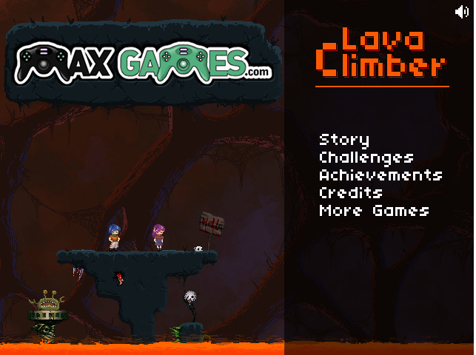
Background Research:
The Cave Jump Lava Climber

Slide 2
Originality Aspect:
Characters choice menu.
Multiple Obstacles/Enemies (Bombs, spikes, bullets).
Rising Lava floor.
Hard Mode

Slide 3
Game Concept:
Storyboard:
Find an object/character from a dungeon/hidden place.
Find the exit.
- Bring it back to the Safe house.
Rules:
Avoid the obstacles (Bombs, spikes, bullets)
Find the door to get to the next level.
Outrun the lava
Gameplay:
- Left and Right arrow for movement.
- Spacebar for jump.
- Down arrow for crouch.
Level design:
Player will face different levels, each level will be harder then the previous one.
Some levels will have walls slowly closing on the character.
Platforms: steady, free, slippery, collapsing.

